Slide 1
INVESTMENT CASE STUDY

Slide 2
Objective /Problem statement
The Spark Funds wants to understand the global trends in investments so that they can take the investment decisions effectively
Constraints:
It wants to invest between 5 to 15 million USD per round of investment
It wants to invest only in English-speaking countries because of the ease of communication with the companies it would invest in.
To analyse and conclaude:
To identify the best sectors, countries, and a suitable investment type for making investments. The overall strategy is to invest where others are investing.
Sub Goals:
Investment type analysis
Country Analysis
Sector Analysis

Slide 3
Data Flow
Load
Companies (ISO-8859-1 – ‘/t’)
Rounds2 (ISO-8859-1 – ‘,’ )
Group by “raised amt
usd”
Lowercase – col
“Permalink”
Lowercase -col
“company_permalink
Calculate mean and sort
Rename -col “company_permalink ” to “permalink”
Take funding roundtype with highest raised amt usd(Venture)
Merge data
(through Inner Merge)
Is “category list” column having “|”
No
Keep value as is.
Is Data null in raised _amt_usd/ country_code/ category_list
Yes
No
Is there unnecessary column
Use “apply” & split value by “|”. Keep 1st value.
Yes
Yes
Clean data by dropping rows
Clean data by dropping column
Make new column “Primary Sector” keep value in it.
A

Slide 4
A
Load Mappings.csv (ISO-8859-1)
Sum and sort “raised
amt usd” after groupby on country code
Filter country
=USA & Raised amount = USD>5M &
<15M
Remove NaN entry from category list
Groupby “Raised amt usd”
D1
Extract top 3 English speaking countries using english speaking country list on wiki
Create main sector column
Create primary sector column
List top 9 countries by
“raised amt usd”
Filter country
=IND & Raised amount = USD>5M &
<15M
Identify top 3 sector from “Main Sector” for D1, D2, D3
Insert all column names where value=1
Insert all category list values in lower case
D2
Filter country code by
“USA”, “GBR”, IND”
Change all “0” to “na” in text
Filter country
=USA & Raised amount = USD>5M &
<15M
Plot graphs
D3
Inner merge to create english speaking frame
Create master mapping
data frame
List top 9 countries by
“raised amt usd”

Slide 5
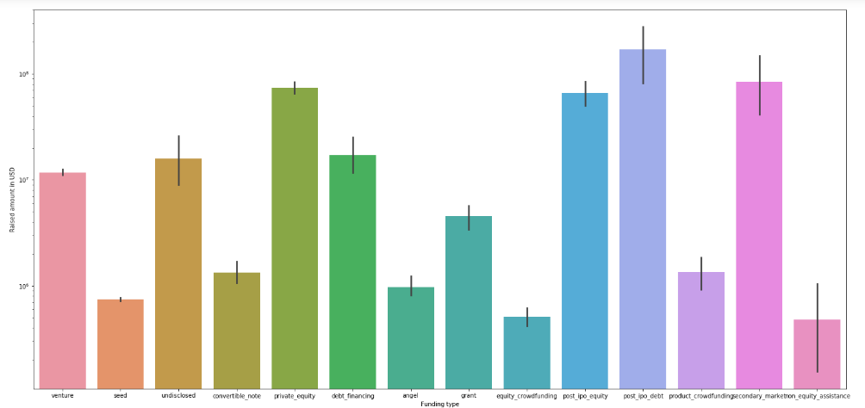
Venture funding type depicted as most suitable

Slide 6
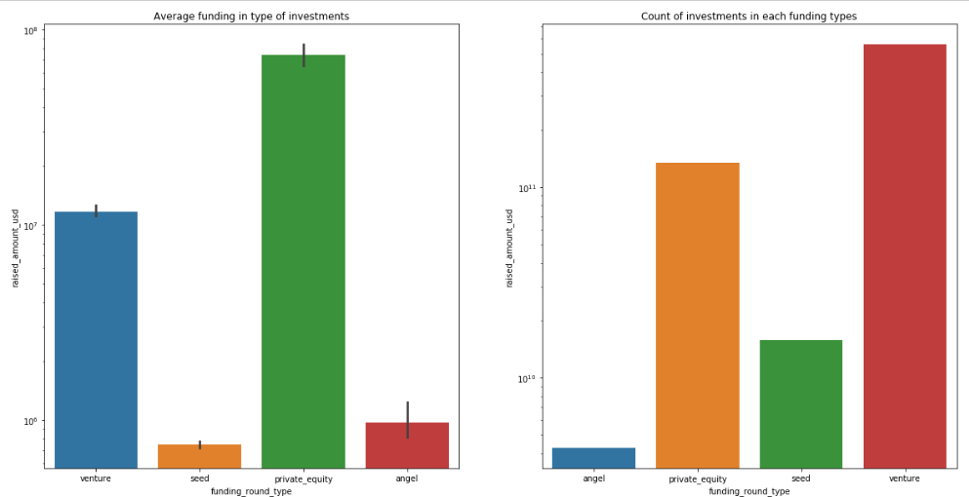
Analysis And Findings

Slide 7
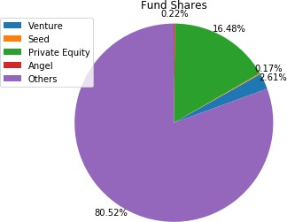
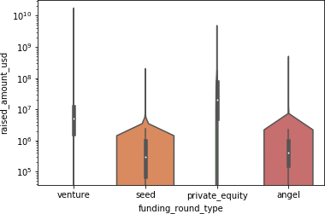
Funding type(seed , private equity ,venture , angel) in market

Slide 8
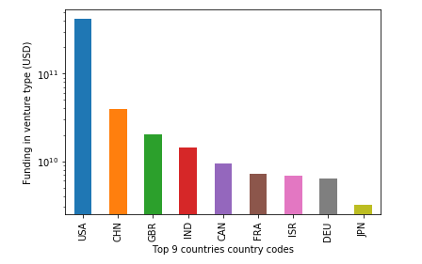
Best countries to invest in

Slide 9
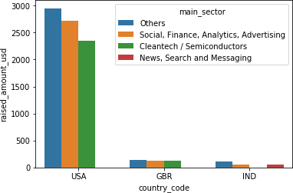
Per country sector wise segregation of potential investment

Slide 10
Findings and conclusion on investment
Best countries have been identified as USA,UK and India.
Best companies for investment have been identified as :
/organization/virtustream and /organization/shotspotter (In USA)
/organization/electric-cloud and /organization/celltick-technologies(In UK)
/organization/firstcry-com and /organization/manthan-systems(In India)
In sectors Social, Finance, Analytics, Advertising is ranking second in best sectors after
others.
Thus it is safe to invest in USA in both virtustream and shotspotter as they are tightly coupled with analytics and cloud services or any other top sector specified in USA.
The second best place to invest would be any company dealing with Social, Finance,
Analytics, Advertising in India or UK

